Slide 1
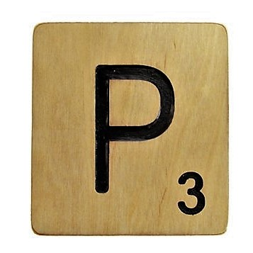
Ezekiel 36:22-38
The New Covenant:
Purpose, People, and Promises
Christopher Cone, ThD, PhD, PhD
www.drcone.com
www.agathonuniversity.com

Slide 3

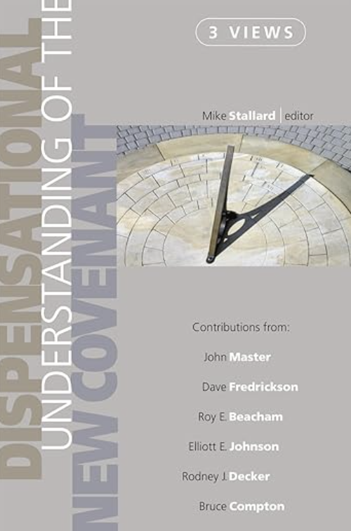

Slide 4
Ezekiel 36:22-38
The New Covenant:
Purpose, People, and Promises
Christopher Cone, ThD, PhD, PhD
www.drcone.com
www.agathonuniversity.com

Slide 5
Ezekiel 36:22-38 Outline
36:22a – People
36:22b-23 – Purpose
36:24-31 – Promises
36:24 – Promise #1: New Location
36:25 – Promise #2: New Cleansing
36:26 – Promise #3: New Heart, New Spirit
36:27 – Promise #4: New Spirit, New Walk
36:28 – Promise #5: New Relationship
36:29 – Promise #6: New Provision
36:30 – Promise #7: New Honor
36:31 – Promise #8: New Humility
36:32-38 – Purpose

Slide 6
Ezekiel 36:22-38 Context
Not referred to as a covenant in Ezekiel 36:22-38, but all 8 aspects of promise presented in Jeremiah 31-33 as part of the NC
(only the Davidic kingdom and Levitical priesthood not discussed in Ezekiel 36:22-38)
Other references include:
Ezekiel 11:17-20, 16:59-62, 37:14,23,26

Slide 7
Ezekiel 36:22-38 Outline
36:22a – People
36:22b-23 – Purpose
36:24-31 – Promises
36:24 – Promise #1: New Location
36:25 – Promise #2: New Cleansing
36:26 – Promise #3: New Heart, New Spirit
36:27 – Promise #4: New Spirit, New Walk
36:28 – Promise #5: New Relationship
36:29 – Promise #6: New Provision
36:30 – Promise #7: New Honor
36:31 – Promise #8: New Humility
36:32-38 – Purpose

Slide 8
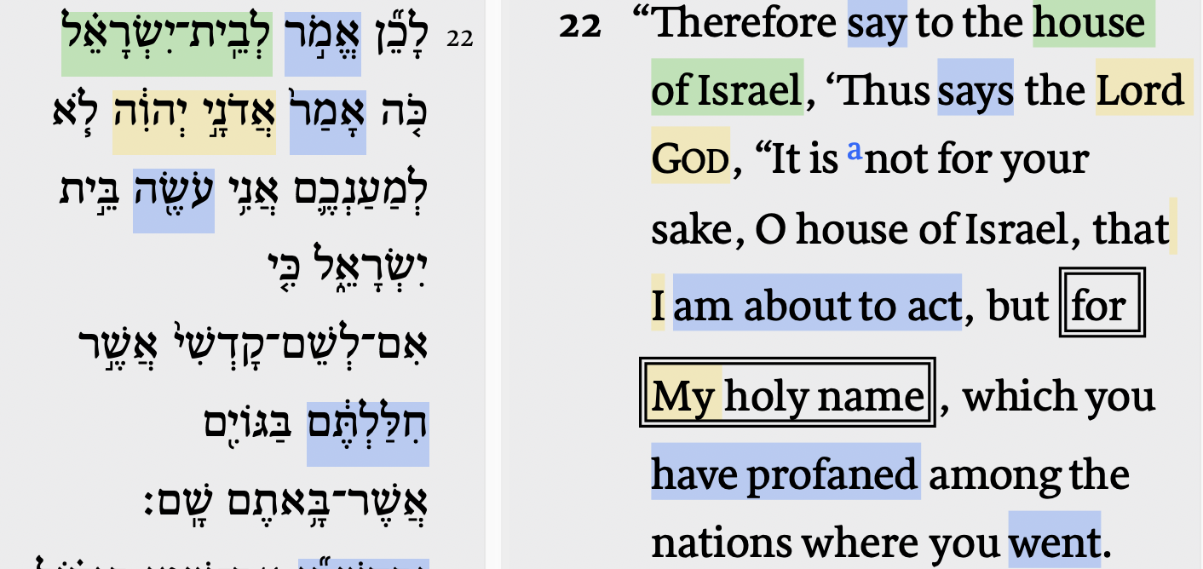
Ezekiel 36:22a People (Israel)

Slide 9
Ezekiel 36:22-38 Outline
36:22a – People
36:22b-23 – Purpose
36:24-31 – Promises
36:24 – Promise #1: New Location
36:25 – Promise #2: New Cleansing
36:26 – Promise #3: New Heart, New Spirit
36:27 – Promise #4: New Spirit, New Walk
36:28 – Promise #5: New Relationship
36:29 – Promise #6: New Provision
36:30 – Promise #7: New Honor
36:31 – Promise #8: New Humility
36:32-38 – Purpose

Slide 10
Ezekiel 36:22b-23 Purpose (Doxological)

Slide 11
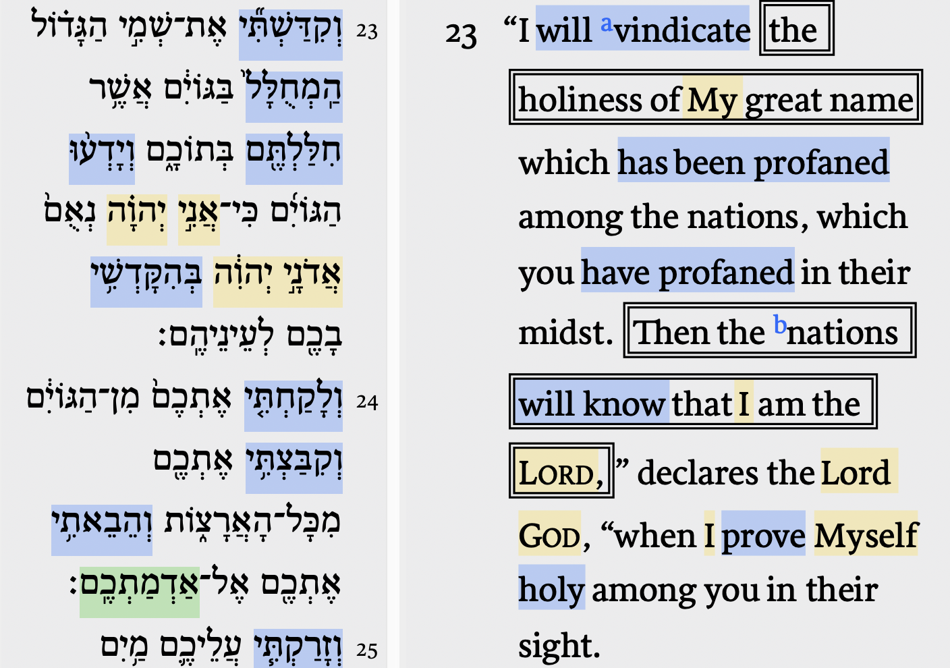
Ezekiel 36:22b-23 Purpose (Doxological)

Slide 12
Ezekiel 36:22-38 Outline
36:22a – People
36:22b-23 – Purpose
36:24-31 – Promises
36:24 – Promise #1: New Location
36:25 – Promise #2: New Cleansing
36:26 – Promise #3: New Heart, New Spirit
36:27 – Promise #4: New Spirit, New Walk
36:28 – Promise #5: New Relationship
36:29 – Promise #6: New Provision
36:30 – Promise #7: New Honor
36:31 – Promise #8: New Humility
36:32-38 – Purpose

Slide 13
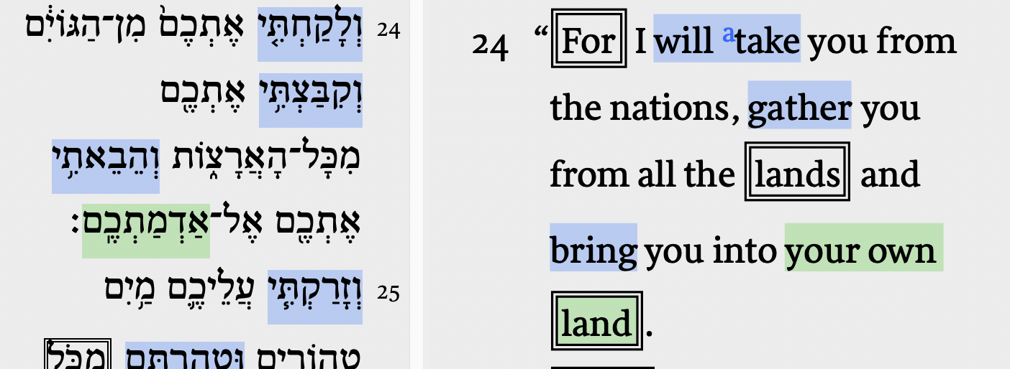
Ezekiel 36:24 Promise: New Location

Slide 14
Ezekiel 36:22-38 Outline
36:22a – People
36:22b-23 – Purpose
36:24-31 – Promises
36:24 – Promise #1: New Location
36:25 – Promise #2: New Cleansing
36:26 – Promise #3: New Heart, New Spirit
36:27 – Promise #4: New Spirit, New Walk
36:28 – Promise #5: New Relationship
36:29 – Promise #6: New Provision
36:30 – Promise #7: New Honor
36:31 – Promise #8: New Humility
36:32-38 – Purpose

Slide 15
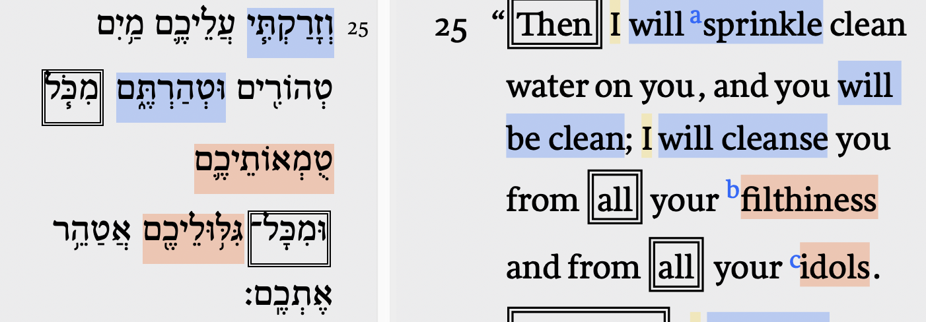
Ezekiel 36:25 Promise: New Cleansing

Slide 16
Ezekiel 36:22-38 Outline
36:22a – People
36:22b-23 – Purpose
36:24-31 – Promises
36:24 – Promise #1: New Location
36:25 – Promise #2: New Cleansing
36:26 – Promise #3: New Heart, New Spirit
36:27 – Promise #4: New Spirit, New Walk
36:28 – Promise #5: New Relationship
36:29 – Promise #6: New Provision
36:30 – Promise #7: New Honor
36:31 – Promise #8: New Humility
36:32-38 – Purpose

Slide 17
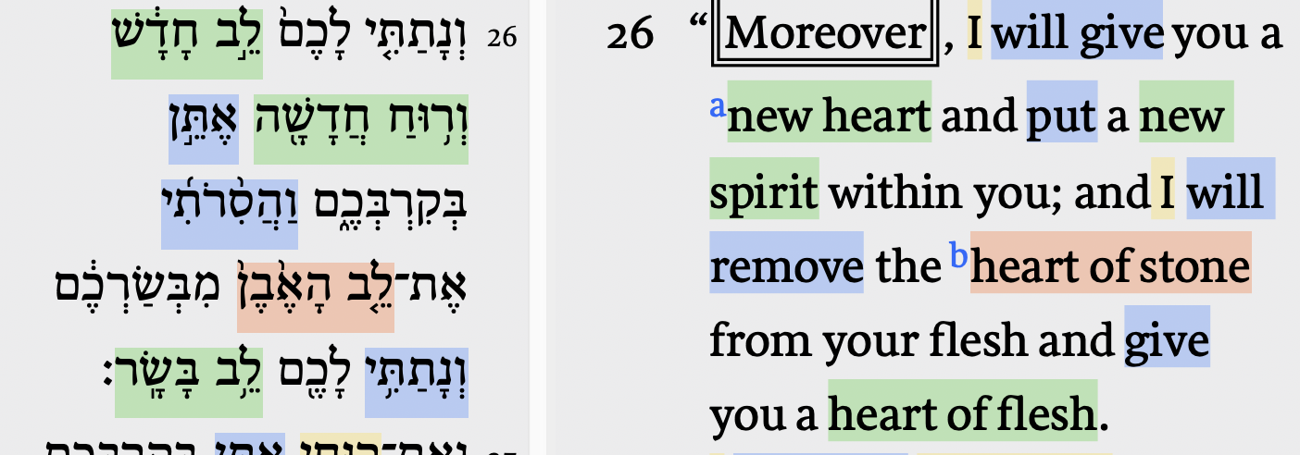
Ezekiel 36:26 Promise: New Heart/Spirit

Slide 18
Ezekiel 36:22-38 Outline
36:22a – People
36:22b-23 – Purpose
36:24-31 – Promises
36:24 – Promise #1: New Location
36:25 – Promise #2: New Cleansing
36:26 – Promise #3: New Heart, New Spirit
36:27 – Promise #4: New Spirit, New Walk
36:28 – Promise #5: New Relationship
36:29 – Promise #6: New Provision
36:30 – Promise #7: New Honor
36:31 – Promise #8: New Humility
36:32-38 – Purpose

Slide 19
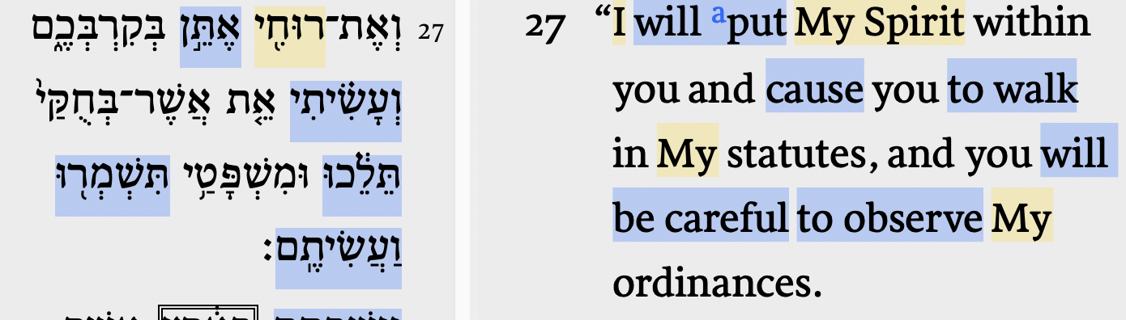
Ezekiel 36:27 Promise: New Spirit/Walk

Slide 20
Ezekiel 36:22-38 Outline
36:22a – People
36:22b-23 – Purpose
36:24-31 – Promises
36:24 – Promise #1: New Location
36:25 – Promise #2: New Cleansing
36:26 – Promise #3: New Heart, New Spirit
36:27 – Promise #4: New Spirit, New Walk
36:28 – Promise #5: New Relationship
36:29 – Promise #6: New Provision
36:30 – Promise #7: New Honor
36:31 – Promise #8: New Humility
36:32-38 – Purpose

Slide 21
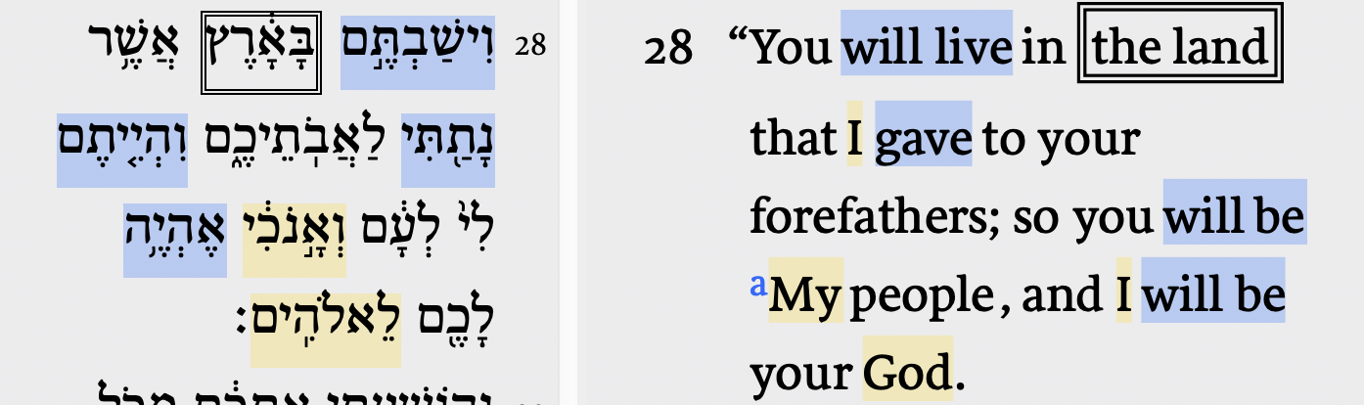
Ezekiel 36:28 Promise: New Relationship

Slide 22
Ezekiel 36:22-38 Outline
36:22a – People
36:22b-23 – Purpose
36:24-31 – Promises
36:24 – Promise #1: New Location
36:25 – Promise #2: New Cleansing
36:26 – Promise #3: New Heart, New Spirit
36:27 – Promise #4: New Spirit, New Walk
36:28 – Promise #5: New Relationship
36:29 – Promise #6: New Provision
36:30 – Promise #7: New Honor
36:31 – Promise #8: New Humility
36:32-38 – Purpose

Slide 23
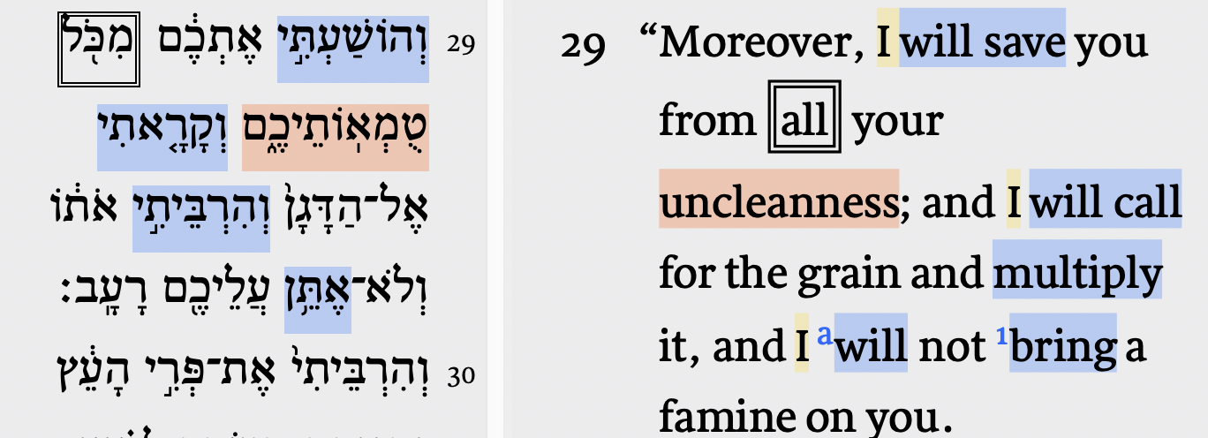
Ezekiel 36:29 Promise: New Provision

Slide 24
Ezekiel 36:22-38 Outline
36:22a – People
36:22b-23 – Purpose
36:24-31 – Promises
36:24 – Promise #1: New Location
36:25 – Promise #2: New Cleansing
36:26 – Promise #3: New Heart, New Spirit
36:27 – Promise #4: New Spirit, New Walk
36:28 – Promise #5: New Relationship
36:29 – Promise #6: New Provision
36:30 – Promise #7: New Honor
36:31 – Promise #8: New Humility
36:32-38 – Purpose

Slide 25
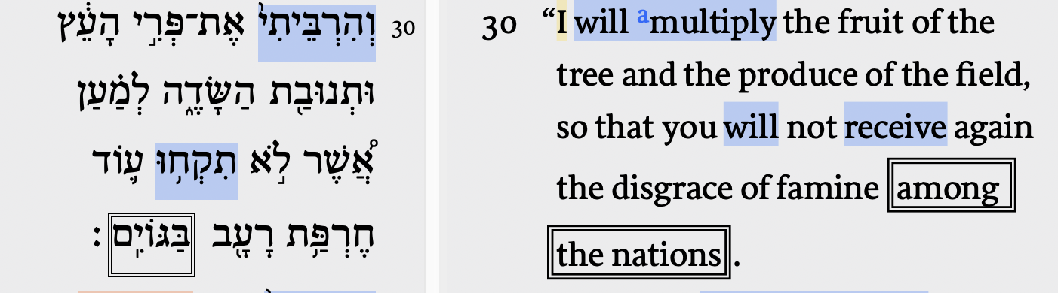
Ezekiel 36:30 Promise: New Honor

Slide 26
Ezekiel 36:22-38 Outline
36:22a – People
36:22b-23 – Purpose
36:24-31 – Promises
36:24 – Promise #1: New Location
36:25 – Promise #2: New Cleansing
36:26 – Promise #3: New Heart, New Spirit
36:27 – Promise #4: New Spirit, New Walk
36:28 – Promise #5: New Relationship
36:29 – Promise #6: New Provision
36:30 – Promise #7: New Honor
36:31 – Promise #8: New Humility
36:32-38 – Purpose

Slide 27
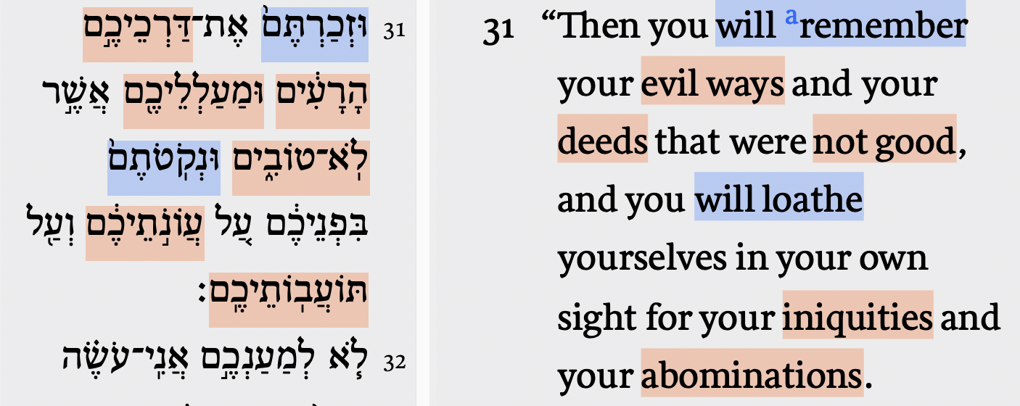
Ezekiel 36:31 Promise: New Humility

Slide 28
Ezekiel 36:22-38 Outline
36:22a – People
36:22b-23 – Purpose
36:24-31 – Promises
36:24 – Promise #1: New Location
36:25 – Promise #2: New Cleansing
36:26 – Promise #3: New Heart, New Spirit
36:27 – Promise #4: New Spirit, New Walk
36:28 – Promise #5: New Relationship
36:29 – Promise #6: New Provision
36:30 – Promise #7: New Honor
36:31 – Promise #8: New Humility
36:32-38 – Purpose

Slide 29
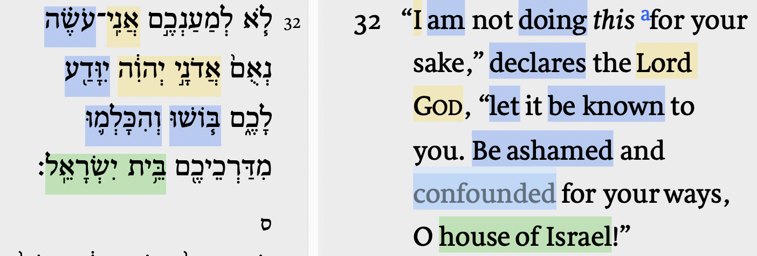
Ezekiel 36:32 Purpose

Slide 30
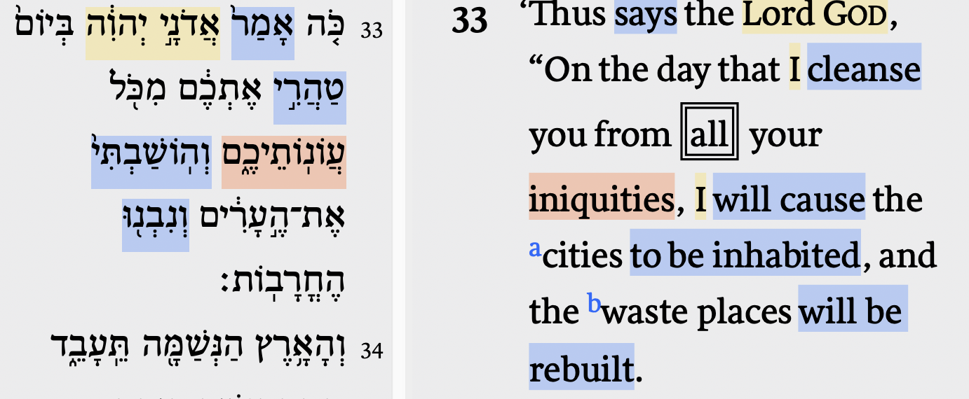
Ezekiel 36:33 Purpose

Slide 31
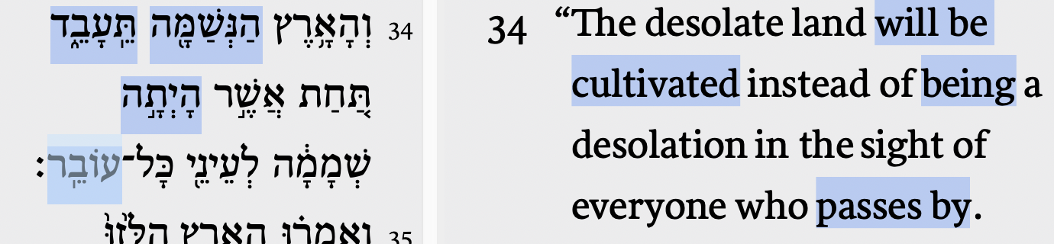
Ezekiel 36:34 Purpose

Slide 32
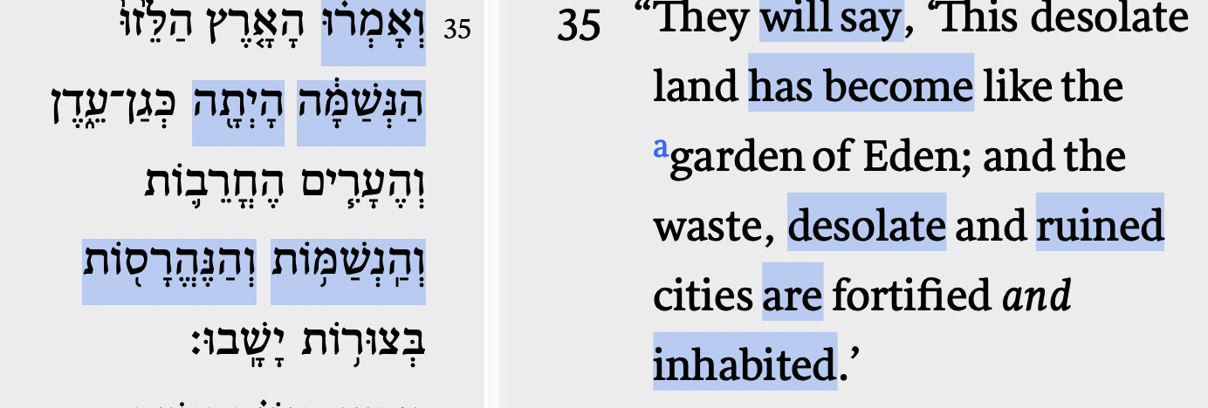
Ezekiel 36:35 Purpose

Slide 33
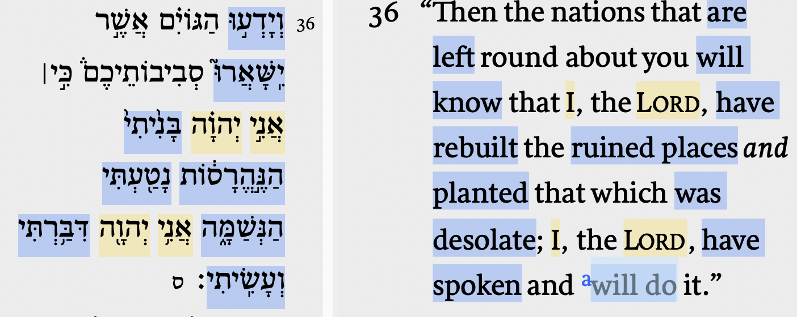
Ezekiel 36:36 Purpose

Slide 34
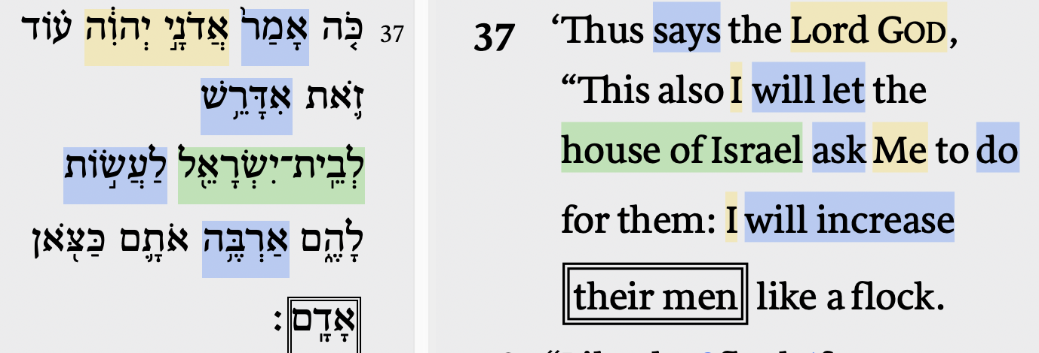
Ezekiel 36:37 Purpose

Slide 35
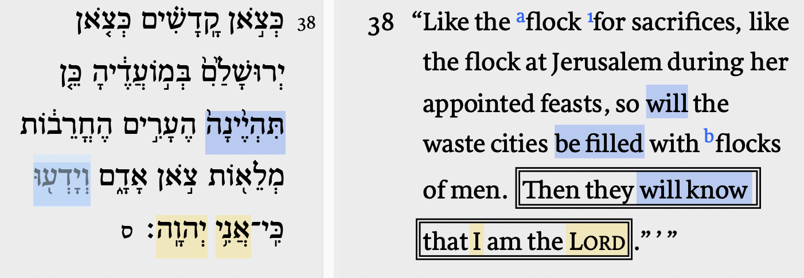
Ezekiel 36:38 Purpose

Slide 36
Ezekiel 36:22-38 Outline
36:22a – People
36:22b-23 – Purpose
36:24-31 – Promises
36:24 – Promise #1: New Location
36:25 – Promise #2: New Cleansing
36:26 – Promise #3: New Heart, New Spirit
36:27 – Promise #4: New Spirit, New Walk
36:28 – Promise #5: New Relationship
36:29 – Promise #6: New Provision
36:30 – Promise #7: New Honor
36:31 – Promise #8: New Humility
36:32-38 – Purpose

Slide 37
Ezekiel 36:22-38 Synopsis
God made promises to Israel, will keep those promises to Israel
God’s promises to Israel include relocation, regeneration, and relationship
God’s purpose is for His name’s sake, to demonstrate His character and glory, and to ensure that all know who He is

Slide 38
Ezekiel 36:22-38
The New Covenant:
Purpose, People, and Promises
Christopher Cone, ThD, PhD, PhD
www.drcone.com
www.agathonuniversity.com

