Slide 1
Be A Man: Love a Woman (Or Don’t), And Father Disciples (Or Don’t)
Christopher Cone, Th.D, Ph.D, Ph.D
www.drcone.com
www.vyrsity.com
www.coloradobiblicaluniversity.com

Slide 2
Be a Man: What Does it Mean to Be a Man?
Session 1: Be a Man – What it Means to Be a Man
Session 2: Love a Woman – What it Means to Be a Husband
Session 3: Or Don’t – What it Means to Be Single
Session 4: Father Disciples – What it Means to Be a Father
Session 5: Or Don’t – What it Means to Be a Discipler

Slide 3
Be A Man: Love a Woman (Or Don’t), And Father Disciples (Or Don’t)
Christopher Cone, Th.D, Ph.D, Ph.D
www.drcone.com
www.vyrsity.com
www.coloradobiblicaluniversity.com

Slide 4
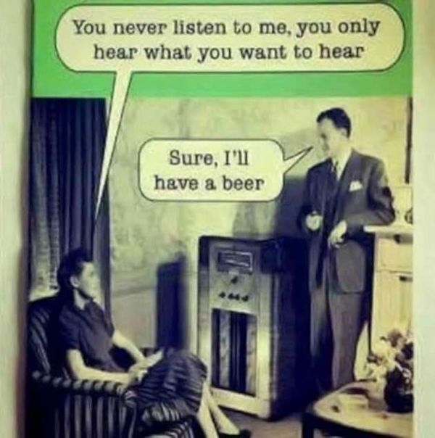
Love A Woman: What Does it Mean to Be a Husband?

Slide 5
Love A Woman: What Does it Mean to Be a Husband?
Positional
Equal – Genesis 1:26-27
Partnered – 1 Corinthians 11:8-9,11,12, 1 Peter 3:7
Ordered – 1 Corinthians 11:3, 7-9
Illustrative – Ephesians 5:30-32
Flawed – Genesis 3:17-20

Slide 6
Love A Woman: What Does it Mean to Be a Husband?
Positional
Equal – Genesis 1:26-27
Partnered – 1 Corinthians 11:8-9,11,12, 1 Peter 3:7
Ordered – 1 Corinthians 11:3, 7-9
Illustrative – Ephesians 5:30-32
Flawed – Genesis 3:17-20
Practical
Subject – Ephesians 5:21
Loving – Ephesians 5:25-28, Colossians 3:19
(1 Corinthians 13:4-8a)
Considerate – 1 Peter 3:7
Fulfilling – 1 Corinthians 7:3-7
Faithful – Proverbs 5, Matthew 5:27-28

Slide 7
Love A Woman: What Does it Mean to Be a Husband?
Positional
Equal – Genesis 1:26-27
Partnered – 1 Corinthians 11:8-9,11,12, 1 Peter 3:7
Ordered – 1 Corinthians 11:3, 7-9
Illustrative – Ephesians 5:30-32
Flawed – Genesis 3:17-20
Practical
Subject – Ephesians 5:21
Loving – Ephesians 5:25-28, Colossians 3:19
(1 Corinthians 13:4-8a)
Considerate – 1 Peter 3:7
Fulfilling – 1 Corinthians 7:3-7
Faithful – Proverbs 5, Matthew 5:27-28
Portrait
Beneficial – Proverbs 31:10-31

Slide 8
Love a Woman: What Does it Mean to Be a Husband?

Slide 9
Be A Man: Love a Woman (Or Don’t), And Father Disciples (Or Don’t)
Christopher Cone, Th.D, Ph.D, Ph.D
www.drcone.com
www.vyrsity.com
www.coloradobiblicaluniversity.com

Slide 10
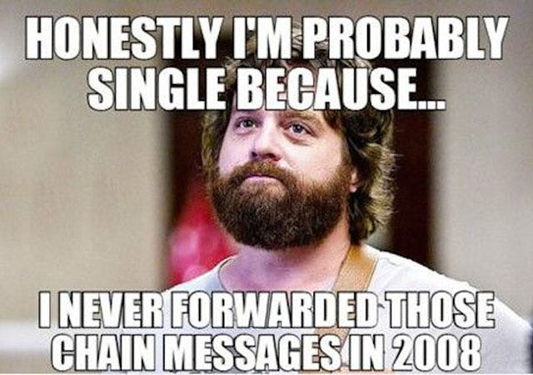
Or Don’t: What Does it Mean to Be Single?

Slide 11
Or Don’t: What Does it Mean to Be Single?
Positional
Gifted – 1 Corinthians 7:1-2, 6-9, 17

Slide 12
Or Don’t: What Does it Mean to Be Single?
Positional
Gifted – 1 Corinthians 7:1-2, 6-9, 17
Practical
Controlled – 1 Corinthians 6:12-20
Content – 1 Corinthians 7:26-32, 39-40
Connected – 1 Corinthians 12:7, 12, 14-18, Hebrews 10:24-25

Slide 13
Or Don’t: What Does it Mean to Be Single?
Positional
Gifted – 1 Corinthians 7:1-2, 6-9, 17
Practical
Controlled – 1 Corinthians 6:12-20
Content – 1 Corinthians 7:26-32, 39-40
Connected – 1 Corinthians 12:7, 12, 14-18, Hebrews 10:24-25
Portrait
Exemplary – 1 Timothy 4:6-16

Slide 14
Be A Man: Love a Woman (Or Don’t), And Father Disciples (Or Don’t)
Christopher Cone, Th.D, Ph.D, Ph.D
www.drcone.com
www.vyrsity.com
www.coloradobiblicaluniversity.com

Slide 15
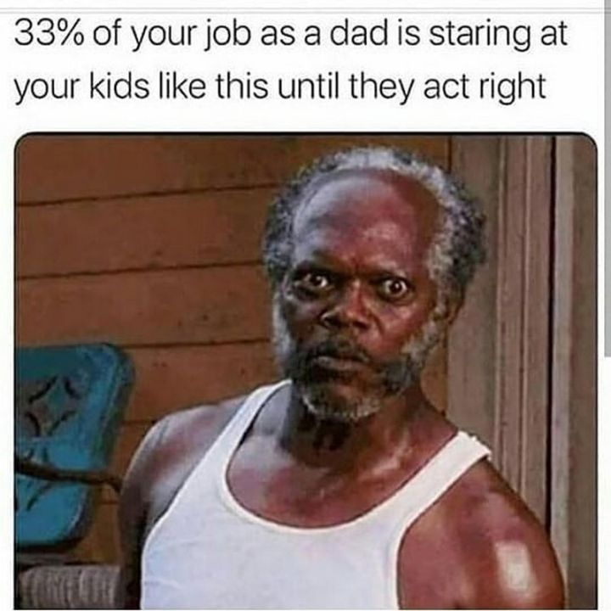
Father Disciples: What Does it Mean to Be a Father?

Slide 16
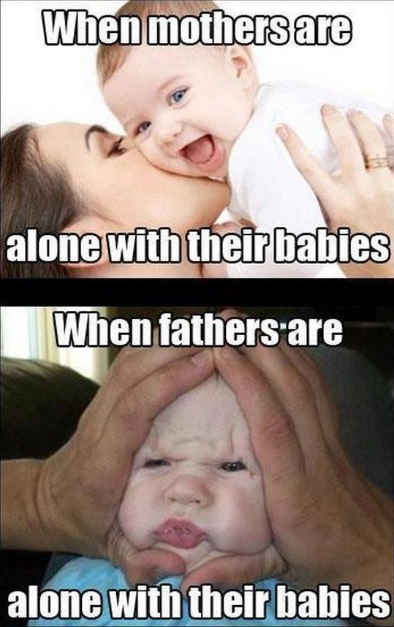
Father Disciples: What Does it Mean to Be a Father?

Slide 17
Father Disciples: What Does it Mean to Be a Father?
Positional
Adopted – Romans 8:15, Ephesians 1:4-5
Knowing – 1 John 2:13-14
Ordered – 1 Timothy 5:1-4
Flawed – Genesis 3:17-20

Slide 18
Father Disciples: What Does it Mean to Be a Father?
Positional
Adopted – Romans 8:15, Ephesians 1:4-5
Knowing – 1 John 2:13-14
Ordered – 1 Timothy 5:1-4
Flawed – Genesis 3:17-20
Practical
Subject – Ephesians 5:21
Purposed – 1 Thessalonians 2:9-12
Example: Deuteronomy 6:2
Encouraging – Colossians 3:21
Loving – Proverbs 3:12, John 15:9, 1 John 3:1, 5:1
Discipling – Ephesians 6:4
Example: Deuteronomy 6:4-9
Method: Proverbs 13:24, 22:6, 15, 23:13-14, 29:15

Slide 19
Father Disciples: What Does it Mean to Be a Father?
Positional
Adopted – Romans 8:15, Ephesians 1:4-5
Knowing – 1 John 2:13-14
Ordered – 1 Timothy 5:1-4
Flawed – Genesis 3:17-20
Practical
Subject – Ephesians 5:21
Purposed – 1 Thessalonians 2:9-12
Example: Deuteronomy 6:2
Encouraging – Colossians 3:21
Loving – Proverbs 3:12, John 15:9, 1 John 3:1, 5:1
Discipling – Ephesians 6:4
Example: Deuteronomy 6:4-9
Method: Proverbs 13:24, 22:6, 15, 23:13-14, 29:15
Portrait
Discipline vs. Punishment – Romans 8:1
Deliberate – Hebrews 12:4-17

