Slide 1
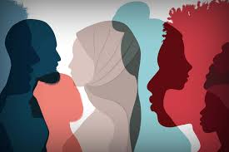
CRITICAL RACE THEORY
and Biblical Perspective
Christopher Cone, Th.D, Ph.D, Ph.D
President / Research Professor
ccone@agathonedu.com
www.agathonedu.com
www.drcone.com

Slide 2
CRITICAL RACE THEORY
Explaining

Slide 3
CRT: Ally or Oppressor?
CRT “teaches kids to hate our country and to hate each other. It is state sanctioned racism and has no place in…schools.”
Ron De Santis, Governor of Florida, tweet, viewed at https://twitter.com/GovRonDeSantis/status/140298375413470412

Slide 4
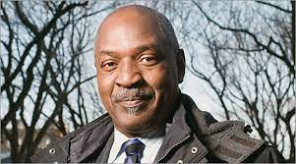
CRT: Ally or Oppressor?
“We still find today a dual system of justice, one black and one white.”
Charles Ogletree, “No Justice, No Peace” 1995 in Race, Rights, and Redemption: The Derrick Bell Lectures on the Law and Critical Race Theory, Kindle version.

Slide 5
CRT: Ally or Oppressor?
“a graduate-level academic framework that encompasses decades of scholarship,”
Jacey Fortin, “Critical Race Theory: A Brief History” New York Times, Nov 8, 2021, https://www.nytimes.com/article/what-is-critical-race-theory.html.

Slide 6
CRT: Ally or Oppressor?
“From critical legal studies, the group borrowed the idea of legal indeterminacy – the idea that not every legal case has one correct outcome. Instead, one can decide most cases either way, by emphasizing one line of authority over another, or interpreting one fact differently from the way one’s adversary does.”
Richard Delgado and Jean Stafancic, Critical Race Theory: An Introduction (New York: New York University Press, 2001), 4-5.

Slide 7
CRT: What is it?
CRT is often focused on critical examination of societal systems – especially in legal contexts – to identify where racism is embedded, and change those systems to create equality

Slide 8
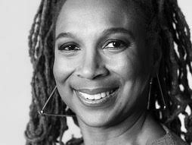
CRT: What is it?
“the goal is to facilitate the inclusion of marginalized groups.”
Kimberle Crenshaw, “Demarginalizing the Intersection of Race and Sex: A Black Feminist Critique of Antidiscrimination Doctrine, Feminist Theory and Antiracist Politics “ in University of Chicago Legal Forum, 1989, Issue 1: 167.

Slide 9
CRT: What is it?
The concerns come with the chosen methodology and the foundational and presuppositional lenses employed for the critique.

Slide 10
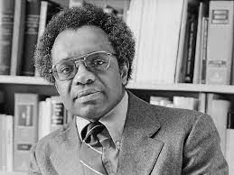
CRT: What is it?
CRT founder Derrick Bell
Rather than offering definitive answers, Bell sought to “provoke discussions.”
Derrick Bell, And We Are Not Saved, 3.
Apparent progress = largely symbolic, but nothing has really changed

Slide 11
CRT: What is it?
“Policemen stand not only for civic order by formal laws and regulations, but also for white supremacy and a whole set of social customs.” Ogletree, Ibid.
Racism remains pervasive and is, in fact, permanent

Slide 12
CRT: What is it?
…[CRT] critiques how the social construction of race and institutionalized racism perpetuate a racial caste system that relegates people of color to the bottom tiers. CRT also recognizes that race intersects with other identities, including sexuality, gender identity, and others. CRT recognizes that racism is not a bygone relic of the past. Instead, it acknowledges that the legacy of slavery, segregation, and the imposition of second-class citizenship on Black Americans and other people of color continue to permeate the social fabric of this nation.
Janel George, “A Lesson on Critical Race Theory” Human Rights Magazine, Vol 46, No. 2, Civil Rights Reimagining Policy, Jan 11, 2021 viewed at https://www.americanbar.org/groups/crsj/publications/human_rights_magazine_home/civil-rights-reimagining-policing/a-lesson-on-critical-race-theory/.

Slide 13
Intersectionality
“Black women are sometimes excluded from feminist theory and antiracist policy discourse because both are predicated on a discrete set of experiences that often does not accurately reflect the interaction of race and gender.” Crenshaw, 140.

Slide 14
Intersectionality
“Black women are protected only to the extent that their experiences coincide with those of either of the two groups [black men, white women].” Crenshaw, 143.
“Because the intersectional experience is greater than the sum of racism and sexism, any analysis that does not take intersectionality into account cannot sufficiently address the particular manner in which Black women are subordinated.” Crenshaw, 140.

Slide 15
Intersectionality
intersectionality – is designed “…to look beneath the prevailing conceptions of discrimination and to challenge the complacency that accompanies belief in the effectiveness of this framework. By so doing, we may develop language which is critical of the dominant view and which provides some basis for unifying activity.”
Crenshaw, 167.

Slide 16
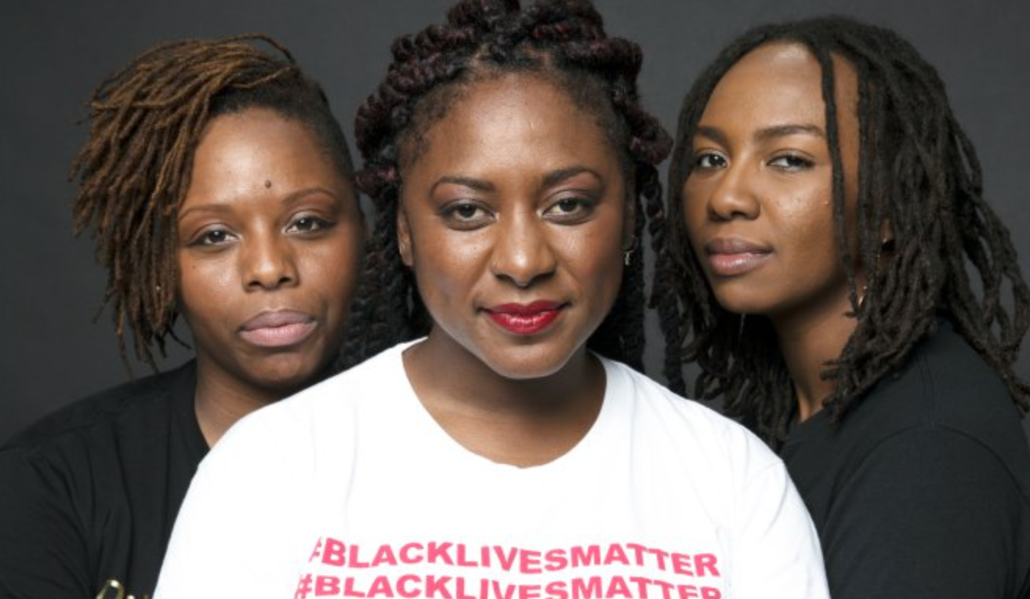
Black Lives Matter (BLM)
“Black liberation movements” create “room, space, and leadership mostly for Black heterosexual, cisgender men — leaving women, queer and transgender people, and others either out of the movement or in the background to move the work forward with little or no recognition.” “Herstory,” viewed at https://blacklivesmatter.com/herstory/.
Alicia Garza, Patrisse Cullors, and Opal Tometi

Slide 17
Black Lives Matter (BLM)
“disrupt[s] the Western-prescribed nuclear family structure requirement by supporting each other as extended families and ‘villages’ that collectively care for one another, especially our children, to the degree that mothers, parents, and children are comfortable.” Quoted by Joshua Rhett Miller, “BLM site removes page on ‘nuclear family structure’ amid NFL vet’s criticism,” New York Post, September 24, 2020, viewed at https://nypost.com/2020/09/24/blm-removes-website-language-blasting-nuclear-family-structure/.

Slide 18
Socio Political or Spiritual?
Diagnosis:

Slide 19
Diagnosing the Problem
CRT, Intersectionality, and BLM – push back against systemic expressions.
As did Platonism – Tripartite society
the ignorant working class – or those driven by appetite, the artisans – should have no say in directing society. They simply aren’t equipped for it. E.g., Plato, Laws, trans. T.J. Saunders (London: Penguin Books, 1970), 23-24.
As did Marxism/Socialism
the human problem was borne of class struggle and the resulting oppression of one class by another. Karl Marx and Friedrich Engels, The Communist Manifesto (New York: Penguin Books, 1967),95.

Slide 20
Diagnosing the Problem
The failure of all systemic resolutions:
these ideologies would necessitate the administration of justice by an unbiased third party, and in these necessities would be found another evidence of the real problem: if the problem is actually a spiritual rather than philosophical or economic one, there can be no unbiased third party.

Slide 21
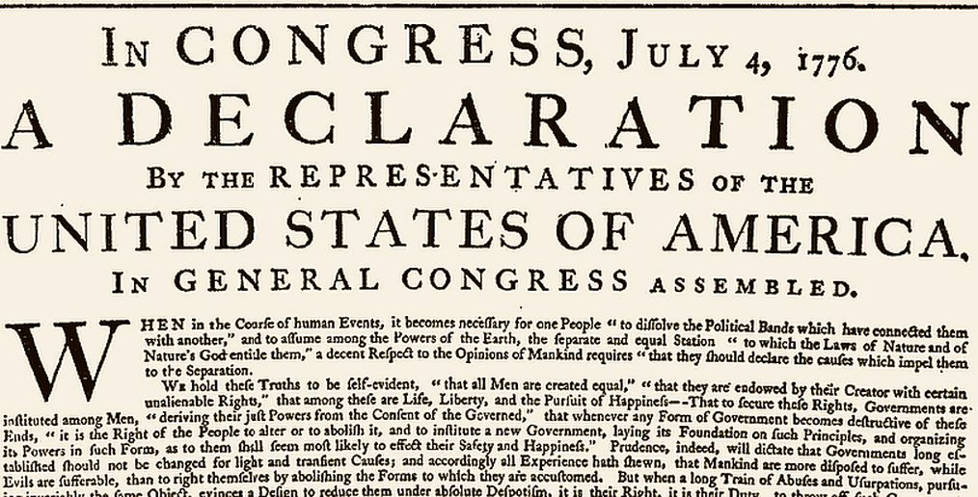
The Spiritual Problem and Racial Implications

Slide 22
Diagnosing the Problem
“Thomas Jefferson owned Sally Hemings and her children, and that his power over them was a right that was weaved into the fabric of the new nation.” Patricia Williams, “The Archetypes that Haunt Us” 1998 in Race, Rights, and Redemption: The Derrick Bell Lectures on the Law and Critical Race Theory, Kindle version.

Slide 23
The System or the People?
some people refused to acknowledge the humanity of others, and thus could in good conscience exclude the less-than-human from the justice demanded by the Declaration and the Constitution.

Slide 24
And God said…
God created humanity (both genders) in His image – Gen 1:26-28, 9:6
All humanity originated from the first couple – Gen 5, 10-11
Thus: no room for ethnicity or gender based oppression
No oppression permitted, only love – Rom 13:10, 1 Tim 1:5
Essential human ethic = love – 1 John 3:11
Distinguishes between good and evil – 1 John 3:12

Slide 25
Evil = Evil
Racism is not just a violation of governmental systems, but more importantly, violation of the image of God in humanity, and thus an offense to God

Slide 26
Mere symptoms…
Socio political and economic failings are symptoms of unrighteousness
The root problem is separation from God
The prescription: reconciliation with God – Eph 2:15-16
He provides peace with God – Rom 5:1
Thus we can have peace with each other – Rom 12:1, 18
Our pursuit is peace, building up each other – Rom 14:19
Our calling is peace – 1 Cor 7:15
Peace is prescribed and enabled – 2 Cor 13:11
Spiritual problem must be resolved first – Eph 2:1-10

Slide 27
Weep With Those Who Weep
Call to Action:

Slide 28
Spiritual Problems Demand Spiritual Solutions
38% of white Christians recognize a current race problem in the United States, while 79% of black Christians acknowledge a race problem
an 11% increase in “Christians who are uninspired to address racial injustice”
The Barna Group, “Black Practicing Christians are Twice as Likely as Their White Peers to See a Race Problem” at Barna.com, June 17, 2020, viewed at https://www.barna.com/research/problems-solutions-racism/.

Slide 29
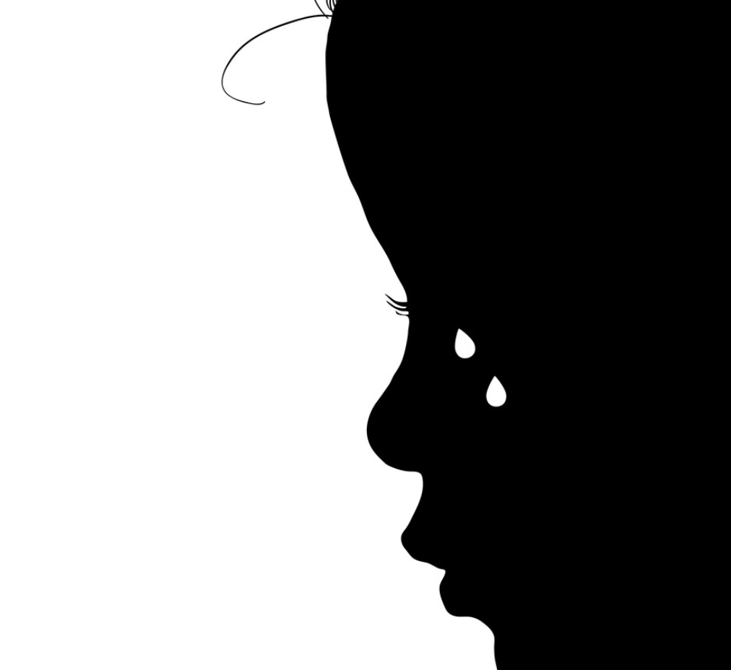
The agony of feeling unloved…

Slide 30
Nothing to Weep About?
it is doubly difficult to write of this period calmly, so intense was the feeling, so mighty the human passions that swayed and blinded men. Amid it all, two figures ever stand to typify that day to coming ages, – the one, a gray-haired gentleman, whose fathers had quit themselves like men, whose sons lay in nameless graves; who bowed to the evil of slavery because its abolition threatened untold ill to all; who stood at last, in the evening of life, a blighted, ruined form, with hate in his eyes; – and the other, a form hovering dark and mother- like, her awful face black with the mists of centuries, had aforetime quailed at that white master’s command, had bent in love over the cradles of his sons and daughters, and closed in death the sunken eyes of his wife, – aye, too, at his behest had laid herself low to his lust, and borne a tawny man-child to the world, only to see her dark boy’s limbs scattered to the winds by midnight marauders riding after “cursed Niggers.” These were the saddest sights of that woful [sic] day; and no man clasped the hands of these two passing figures of the present-past; but, hating, they went to their long home, and, hating, their children’s children live today.
W.E.B. Dubois, The Souls of Black Folk (Oxford, UK: Oxford University Press, 2007), 26.

Slide 31
Nothing to Weep About?
9 Let love be without hypocrisy. Abhor what is evil; cling to what is good. 10 Be devoted to one another in brotherly love; give preference to one another in honor; 11 not lagging behind in diligence, fervent in spirit, serving the Lord; 12 rejoicing in hope, persevering in tribulation, devoted to prayer, 13 contributing to the needs of the saints, practicing hospitality.
14 Bless those who persecute you; bless and do not curse. 15 Rejoice with those who rejoice, and weep with those who weep. 16 Be of the same mind toward one another; do not be haughty in mind, but associate with the lowly. Do not be wise in your own estimation. 17 Never pay back evil for evil to anyone. Respect what is right in the sight of all men. 18 If possible, so far as it depends on you, be at peace with all men. – Romans 12:9-18

Slide 32
Will There Be Justice?
Humanity is created in His image – Gen 1:26-28
Humanity is one race and one blood – Gen 5, 10-11
God values every individual as His and as human – Gen 9:5-6
He promises to bless every people of the earth – Gen 12:3b
Every tribe, tongue, and people will see blessing through His grace – Rev 5:9, 7:9, 14:6
Weeping will one day be wiped away – Rev 21:4

Slide 33
What Sort of People Should We Be?
9 Let us not lose heart in doing good, for in due time we will reap if we do not grow weary.
10 So then, ªwhile we have opportunity, let us do good to all people, and especially to those who are of the household of the faith. – Gal 6:9-10

Slide 34
7 now, will not God bring about justice for His elect who cry to Him day and night, and will He delay long over them?
8 “I tell you that He will bring about justice for them quickly. However, when the Son of Man comes, will He find faith on the earth?” – Luke 18:7-8

