Slide 1
FORWARD IN WRITING
Dr. Christopher Cone
drcone.com
calvary.edu

Slide 2
Forward in WRITING
Biblical Purpose
Strategic Purpose
Practical Methods and Tools

Slide 3
Biblical Purpose in Writing

Slide 4
Biblical purpose in writing
God is a God of communication (Gen 1-2)
Thus says the Lord x 419 OT
Spoke in many ways (Heb 1:1-2)
Communicated in His Son (Jn 1:14-18)

Slide 5
Biblical purpose in writing
God is a God of communication (Gen 1-2)
Thus says the Lord x 419 OT
Spoke in many ways (Heb 1:1-2)
Communicated in His Son (Jn 1:14-18)
God values, uses written language (2 Tim 3:16, Ex 17:14, Rev 21:5)

Slide 6
Biblical purpose in writing
God desires His people to:
Teach one another (Col 3:16-17, Tt 2:3)
Make disciples (Mt 28:19, 2 Tim 2:2)
Proclaim His hope (1 Pet 3:15)

Slide 7
Biblical purpose in writing
God desires His people to:
Teach one another (Col 3:16-17, Tt 2:3)
Make disciples (Mt 28:19, 2 Tim 2:2)
Proclaim His hope (1 Pet 3:15)
How can we do that most effectively in various contexts?

Slide 8
STRATEGIC Purpose in Writing

Slide 9
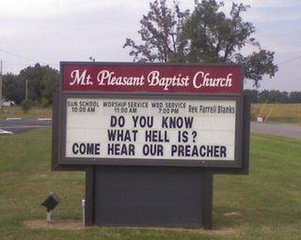
STRATEGIC purpose in writing
Allows asynchronous communication (Is 30:8)

Slide 10
STRATEGIC purpose in writing
Allows asynchronous communication (Is 30:8)
Allows precision (Lk 1:3-4)

Slide 11
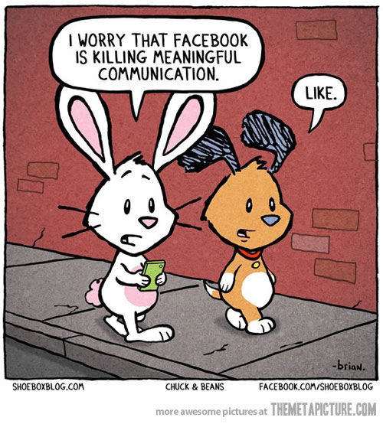
STRATEGIC purpose in writing
Allows asynchronous communication (Is 30:8)
Allows precision (Lk 1:3-4)
Creates a record (Ex 17:14, Deut 6:6,9)

Slide 12
STRATEGIC purpose in writing
Allows asynchronous communication (Is 30:8)
Allows precision (Lk 1:3-4)
Creates a record (Ex 17:14, Deut 6:6,9)
Allows broadcasting (Rev 1:11)

Slide 13
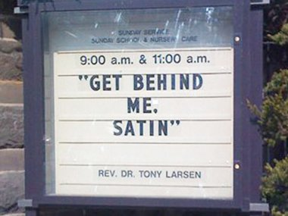
STRATEGIC purpose in writing
Allows asynchronous communication (Is 30:8)
Allows precision (Lk 1:3-4)
Creates a record (Ex 17:14, Deut 6:6,9)
Allows broadcasting (Rev 1:11)
Aids visual learning (Gal 6:11, Rev 1:11)

Slide 14
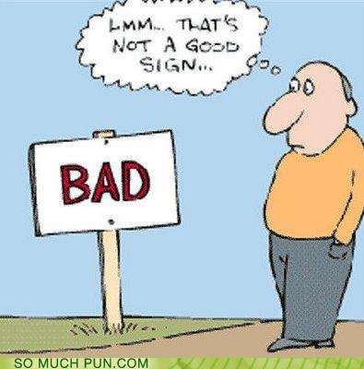
STRATEGIC purpose in writing
Allows diverse presentation (2 Cor 13:10)

Slide 15
STRATEGIC purpose in writing
Allows diverse presentation (2 Cor 13:10)
Allows compounding (Heb 1:1-2)

Slide 16
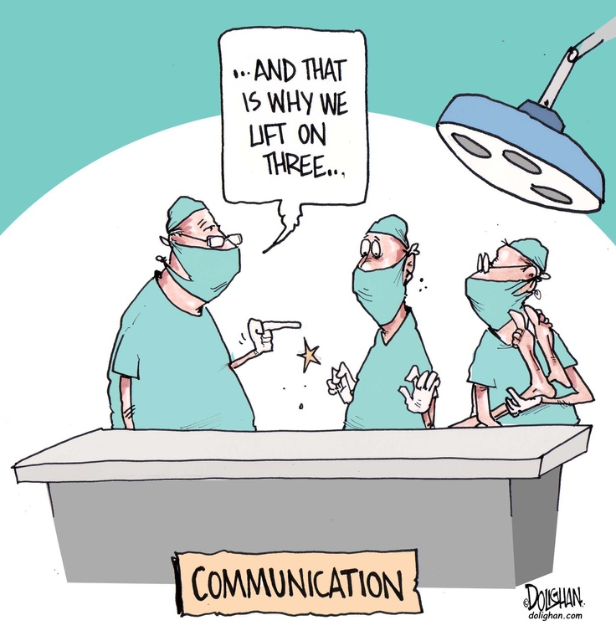
STRATEGIC purpose in writing
Allows diverse presentation (2 Cor 13:10)
Allows compounding (Heb 1:1-2)
Provides at-your-own-pace instruction (1 Cor 4:14-16)

Slide 17
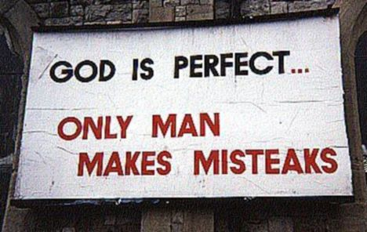
STRATEGIC purpose in writing
Allows diverse presentation (2 Cor 13:10)
Allows compounding (Heb 1:1-2)
Provides at-your-own-pace instruction (1 Cor 4:14-16)
Provides a safeguard (Php 3:1)

Slide 18
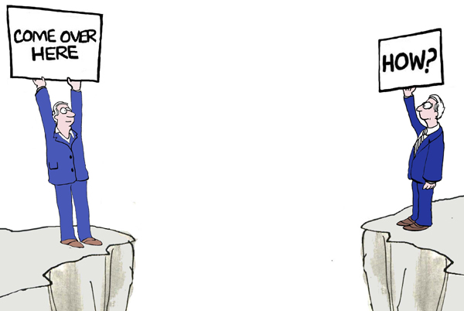
STRATEGIC purpose in writing
Allows diverse presentation (2 Cor 13:10)
Allows compounding (Heb 1:1-2)
Provides at-your-own-pace instruction (1 Cor 4:14-16)
Provides a safeguard (Php 3:1)
Can stir the mind (2 Pet 3:1)

Slide 19
PRACTICAL METHODS AND TOOLS

Slide 20
9 questions for beginning writing
1. What am I responsible for?
2. What am I passionate about?
3. What do I have to offer in those areas?
4. Who else writes on those topics, and what can I learn from them?
5. Who am I trying to reach? What is their age and other demographics?

Slide 21
9 questions for beginning writing
6. Who else is effective in reaching those demographics, and what can I learn from them?
7. How to decide when to address an issue or not?
8. How is God using me to edify others, and could that ministry be broadened through writing?
9. How can I improve my personal communication to others through writing?

Slide 22
10 Steps for beginning writing
1. Answer the 9 questions
2. Begin to develop a habit of writing. Start small.
3. Begin writing brief comments on passages, write brief notes to edify others.
4. Open “new media” accounts, begin to become familiar with these tools

Slide 24
9 Steps for beginning writing
5. Begin to learn reading, viewing habits of audience
6. Begin to learn how to use pictures, video, multimedia
7. Find likeminded media sources (people, blogs, etc.) to follow.
8. Communicate with other writers, seek counsel

Slide 25
9 Steps for beginning writing
9. Write! Write! Write!
Status update (40 characters is best)
Tweet (71-100 characters is best)
Blog post (300-700 words)
Editorial (700-900 words)
Journal Article (8,000 –12,000 words)
Book (50,000 – 100,000 words)
10. Redeem the moments. Use small moments. Don’t wait for big ones.

Slide 26
11 The words of wise men are like goads, and masters of these collections are like well-driven nails; they are given by one Shepherd. 12 But beyond this, my son, be warned: the writing of many books is endless, and excessive devotion to books is wearying to the body. – Ecclesiastes 12:11-12

