Slide 1
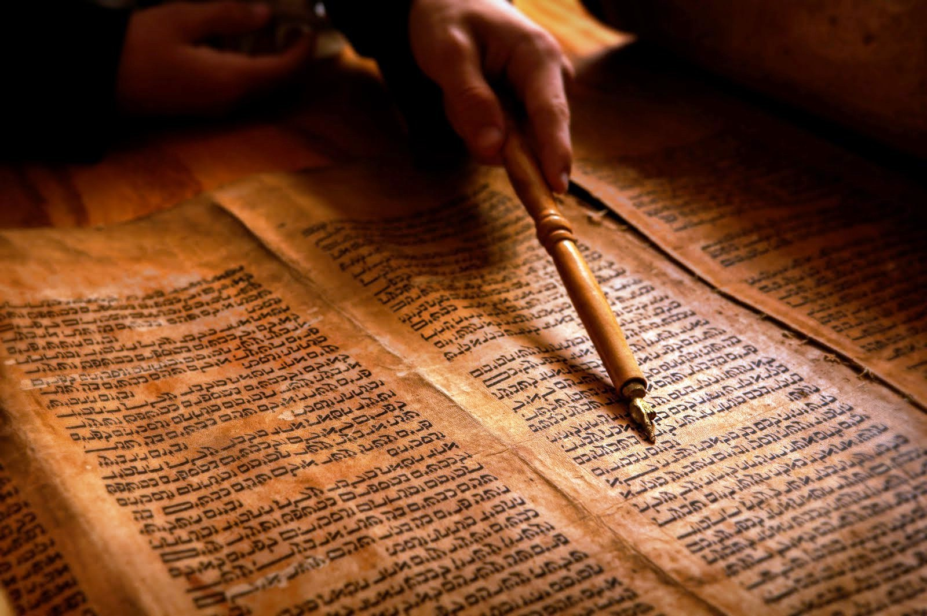
PROPHECY AND
THE BIBLICAL WORLDVIEW
Dr. Christopher Cone
drcone.com
calvary.edu

Slide 2


Slide 3
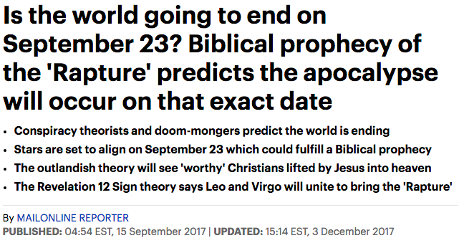
Those who do believe in the Rapture attribute their beliefs to two specific Bible scriptures.
According to 1 Thessalonians 4:16-17, the heavens will open during the end of days, with God lifting those who are alive 'into the clouds'.
And 2 Peter 3:10, says: 'But the day of the Lord will come as a thief in the night, in which the heavens will pass away with a great noise, and the elements will melt with fervent heat; both the earth and the works that are in it will be burned up.'
http://www.dailymail.co.uk/news/article-4887222/Biblical-prophecy-predicts-Rapture-September-23.html#ixzz57xH84e9n

Slide 4
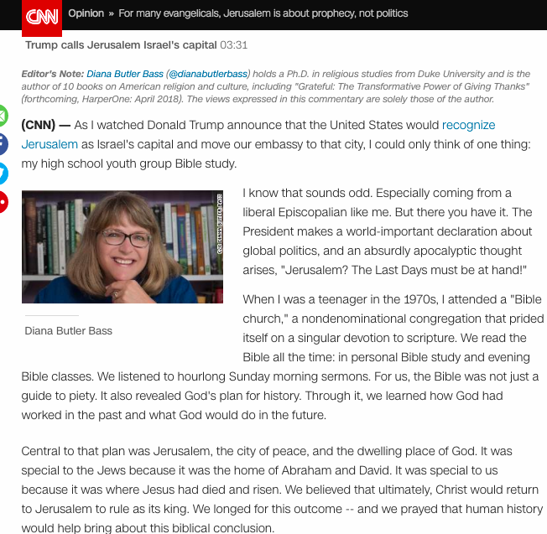
This theology -- a literal belief that all these things must happen before Jesus will return to reign on Earth -- is called "dispensational pre-millennialism" and it is not the quirky opinion of some isolated church. Although the majority of Christians do not share these views, versions of dispensational pre-millennialism dominate American evangelicalism.
https://www.cnn.com/2017/12/08/opinions/jerusalem-israel-evangelicals-end-times-butler-bass-opinion/index.html

Slide 5
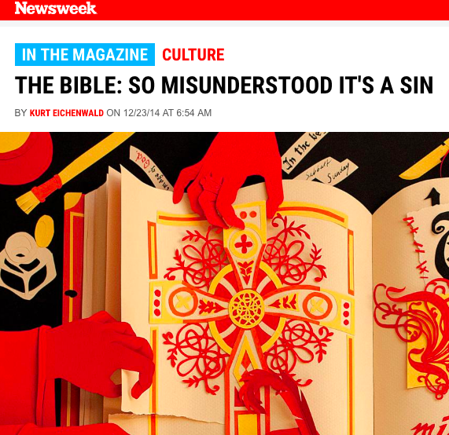
They are God’s frauds, cafeteria Christians who pick and choose which Bible verses they heed with less care than they exercise in selecting side orders for lunch. They are joined by religious rationalizers—fundamentalists who, unable to find Scripture supporting their biases and beliefs, twist phrases and modify translations to prove they are honoring the Bible’s words.

Slide 6
This is no longer a matter of personal or private faith. With politicians, social leaders and even some clergy invoking a book they seem to have never read and whose phrases they don’t understand, America is being besieged by Biblical illiteracy. Climate change is said to be impossible because of promises God made to Noah; Mosaic law from the Old Testament directs American government; creationism should be taught in schools; helping Syrians resist chemical weapons attacks is a sign of the end times—all of these arguments have been advanced by modern evangelical politicians and their brethren, yet none of them are supported in the Scriptures as they were originally written.

Slide 7
So why study the Bible at all? Since it’s loaded with contradictions and translation errors and wasn’t written by witnesses and includes words added by unknown scribes to inject Church orthodoxy, should it just be abandoned?
No. This examination is not an attack on the Bible or Christianity. Instead, Christians seeking greater understanding of their religion should view it as an attempt to save the Bible from the ignorance, hatred and bias that has been heaped upon it. If Christians truly want to treat the New Testament as the foundation of the religion, they have to know it. Too many of them seem to read John Grisham novels with greater care than they apply to the book they consider to be the most important document in the world

Slide 8

Forty-five percent say the Bible has had the biggest influence on their views of Israel.
Sixty-three percent say they support Israel primarily because “God gave the land of Israel to the Jewish people.”
Twenty-two percent are not sure if biblical promises about the land of Israel are still in force.
Eighty percent say God promised the land of Israel to Abraham and his descendants for all time.
Eighty percent say the rebirth of Israel in 1948 was a fulfillment of biblical prophecy.
https://lifewayresearch.com/2017/12/04/support-of-israel-among-younger-evangelicals/

Slide 9

Where
does
Biblical prophecy fit???

Slide 11
Prophecy and “Is”

Slide 12
Prophecy and Epistemology

Slide 13
Source of Authority:
Fulfilled Prophecy in the Creation Week
1:3, 6, 9(x2), 11, 14, 15, 20 (x2), 24, 26
11 fulfilled prophecies demonstrate His sovereignty, and rights as Creator

Slide 14
Interpreting Authority (Hermeneutics):
Fulfilled Prophecy in Genesis
2:16-17 – spiritual death from sin
2:18 – a helper
3:19/5:5 – physical death from sin
6-9 – deliverance through judgment
17-18/21 – a son
19 – judgment, looking back
31 – striped and spotted sheep
32:28, 35:10 – Israel
37, 40-41 – dreams come true
Fulfilled prophecy in Genesis provides a hermeneutic model for the rest of prophecy.

Slide 15
Prophecy and Metaphysics

Slide 16
Prophecy and Metaphysics: Pessimism?
People grow more….awful (2 Tim 3:1-5)
More wars and more unstable environment (Mt 24:7)
A third of the vegetation is burned up (Rev 8:7)
A third of all sea creatures killed (Rev 8:9)
A third of all fresh water polluted (Rev 8:10-11)
A third of humanity is killed by war (Rev 9:15)
A third of sun, moon and stars fail to give light (Rev 8:12)
Heaven and earth pass away (Rev 21:1) with intense heat (2 Pet 3:10)

Slide 17
Prophecy and Metaphysics: Apathy?
1 Thessalonians 4:13-17
13 But we do not want you to be uninformed, brethren, about those who are asleep, so that you will not grieve as do the rest who have no hope.
14 For if we believe that Jesus died and rose again, even so God will bring with Him those who have fallen asleep in Jesus.
15 For this we say to you by the word of the Lord, that we who are alive and remain until the coming of the Lord, will not precede those who have fallen asleep.
16 For the Lord Himself will descend from heaven with a shout, with the voice of the archangel and with the trumpet of God, and the dead in Christ will rise first.
17 Then we who are alive and remain will be caught up together with them in the clouds to meet the Lord in the air, and so we shall always be with the Lord.

Slide 19
Prophecy and “Ought”

Slide 20
Prophecy and Ethics

Slide 21
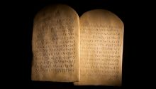
Models for understanding Biblical ethics are largely determined by how one views the prophecies regarding the Mosaic Law and the New Covenant.

Slide 22
3 Views on Biblical Ethics
Continuity – three categories of Law (moral, civil, ceremonial) all still in effect.
  Theonomy, Reconstructionism
  Rooted in authority is law (good is being like God)
Semi Continuity – moral Law still in effect for sanctification
  Reformed
  Rooted in authority is law (good is being like God)
Discontinuity – the Law not applicable for sanctification
  Dispensational
  Rooted in authority over law (God is over law)

Slide 23
A Continuity Model
Rooted in authority is law (strong)
“The abiding validity of the Law” (Bahnsen, “Theonomy in Christian Ethics, ch. 2)
Matthew 5:17 shows that moral, civil, and ceremonial are all equally applicable
Ceremonial Law as restorative

Slide 24
A Continuity Model
“The accomplishment of redemption changes the way in which we observe the ceremonial law, and the change of culture and times alters the specific ways in which we observe the case laws. The cases are different but the same moral principles remain.” (Greg Bahnsen, “The Faculty Discussion of Theonomy,” Question 9, http://www.cmfnow.com/articles/pe192.htm, 1978, at RTS)
The James 2:10 problem

Slide 25
A Semi-Continuity Model
The prevailing view of the church (David Jones, Introduction to Biblical Ethics (Nashville: TN, B&H Academic, 2013), 76.)
Acts 15 ruled the ceremonial law not applicable to NT believers
NT voices approval of non-theocratic governments (e.g., Rom 13:1-5, 1 Pet 2:13-17), thus civil law, not applicable
Moral law is for sanctification (Jones, 139)
Rooted in authority is law (weak)

Slide 26
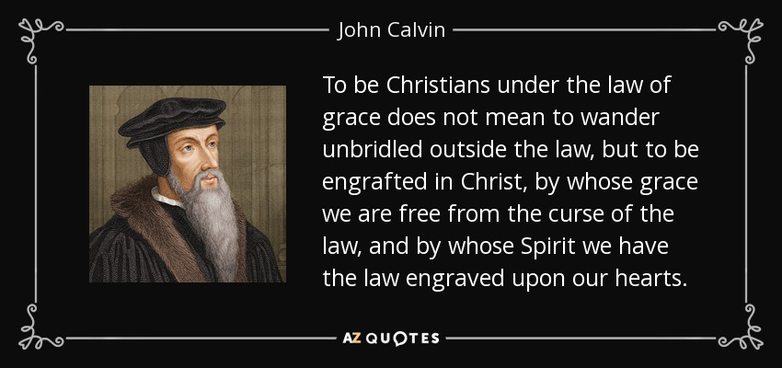

Slide 28
A Semi-Continuity Model
“The law sends us to the gospel that we may be justified, and the gospel sends us to the law again to enquire what is our duty in being justified.” (Samuel Bolton, True Bonds of Christian Freedom (London:UK, Banner of Truth, 1964), 80)
“Since the Decalogue is a reflection of God’s moral character, the norms codified in the Ten Commandments are universally applicable and demonstrable both before and after their issuance on Mount Sinai.” (Jones, 139.)

Slide 29
A Semi-Continuity Model
“As the kingdom of God grows, then the gospel gradually counteracts and corrects the effects of sin in the world through the process of restoration and reconciliation…the gospel is no less comprehensive than the fall…” (Jones, 64.)
The James 2:10 problem

Slide 30
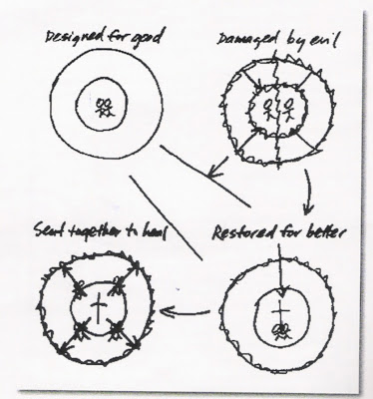

Slide 31
A Semi-Continuity Model
“For Christians, then, the Sabbath is a sign of redemption and, as such, it depicts the eternal rest they have received from Jesus in salvation…Keeping the Sabbath ought not to be a legalistic burden, characterized by lists of permitted and forbidden activites. Rather the Sabbath ought to be a joyous celebration and a blessing…In a specific sense the fourth commandment calls believers to observe a regular day of worship…not to observe the Sabbath, in either a broad or a specific sense, is to behave in a distinctly un-Christlike manner…in the NT…the early church moved the day of Sabbath observance to the first day of the week.” (Jones, 166.)
The James 2:10 problem

Slide 32
A Discontinuity Model
Mosaic Law not ethically applicable to church
Must be rooted in authority over law, if consistent
Cannot make use of the threefold division of law if consistent
One ethical standard (the holiness of God), Two distinct ethics applications: for unbelievers, and believers

Slide 33
A Discontinuity Model: Ethics for Unbelievers
Vertical
  Universal accountability – Rom 1:18-21, (Romans 1-3), Mt 5:48
  Sanctity of life, a universal mandate, Gen 9:6, based on imago dei
  Belief in Jesus
    Eph 2:1-3 – nature of unbelievers
    Heb 11:6 – no ethical value outside of faith
    Jn 6:47, 20:31, Jn 20:27
Horizontal
  Sanctity of life, universal mandate, Gen 9:6, based on imago dei

Slide 34
A Discontinuity Model: Ethics for Believers
Vertical
  Sanctity of life, a universal mandate, Gen 9:6, based on imago dei
  Through belief, accountability and faith mandate met
  Be obedient, by being holy (1 Pet 1:14-16)
  Be holy by loving God (Mt 22:37-40, 1 Cor 16:22)
    Assuming Mt 28:20 refers to Jesus’ commands to love (Mt 22:37-40 – not just grounded in the Law, but also the Prophets)
  Love God by being obedient (Jn 14:15, 21, 24, 15:10, 1 Jn 5:2-3)
  Holiness, obedience, and love expressed in many specific ways (some vertical some horizontal)

Slide 35
A Discontinuity Model: Ethics for Believers
Horizontal
  Sanctity of life, a universal mandate, Gen 9:6, based on imago dei
  Love believers (Mt 22:37-40, Jn 13:34-35, 15:12-13, 1 Jn 4:7, 5:2)
    Love seeks benefit for others: Gal 6:10, Php 2:3-5, Heb 10:24
    Primary need of others? Sanctification
  Love unbelievers (Mt 22:37-40, 5:44, Lk 10:29-37, Rom 12:19-21, 1 Cor 5:9-13, Col 4:5-6, 2 Tim 2:24)
    Love seeks benefit for others: Jn 3:16, Gal 6:10, Eph 2:3-7, Php 1:15-18
    Primary need of others? Justification

Slide 36
A Discontinuity Model: Implications
Follows from Biblical epistemology (consistently literal grammatical historical hermeneutic)
Follows from Biblical metaphysics
  God is holy (ontology)
  God determines good (axiology)
  All for God’s glory (teleology)
  God will be glorified (eschatology
Provides certainty in specific ethics situations
Leads to specific social political thinking

Slide 37
Prophecy and Socio-Political

Slide 38

Prophecy and Socio-Political
“If you believe that you’re going to leave and evacuate to somewhere else, then why do anything about this world?”
(Rob Bell, Love Wins (New York, NY: Harper Collins, 2011), 46.)

Slide 39
Artificial Methods to Avoid Pessimism and Apathy
Genre override
  Apocalyptic
  Myth
Allegorical hermeneutics
Canonical/complementary hermeneutics
Theological hermeneutics
Postmodern hermeneutics

Slide 40
Artificial Conclusion to Avoid Pessimism and Apathy: Kingdom is Now!
Postmillennialism – Christ returns after the kingdom begins
Amillennialism – the kingdom is a current spiritual reality
Preterism (full and partial) – some are postmil, others amil
Covenant Premillennialism – while there is a future earthly kingdom, a spiritual component is in place now
Progressive dispensationalism – similar to covenant premillennialism
Classical dispensationalism – some hold to “mystery form” of the kingdom (from Mt 13:11, Mk 4:11, Lk 8:10)
    Mt 13:11 - Jesus answered them, “To you it has been granted to know the mysteries of the kingdom of heaven, but to them it has not been granted.

Slide 41
Implications of Kingdom Now Theology
“The kingship of the Messiah is the sovereignty of the Truth which He reveals and embodies. In virtue of this He demands obedience from all men.” (C. H. Dodd, The Interpretation of the Fourth Gospel (Cambridge, UK: Press Syndicate of the University of Cambridge, 1953), 229.)
…so that at the name of Jesus every knee will bow, of those who are in heaven and on earth and under the earth…Php 2:10

Slide 42
Implications of Kingdom Now Theology
…This future America will be again a “city on a hill” drawing all nations to the Lord Jesus Christ and teaching them to subdue the earth for the advancement of His kingdom. (American Vision, “About:Vision,” at http://americanvision.org/about/#.T-krbitYta8. Viewed 6/25/2012.)
‘Your kingdom come. Your will be done, On earth as it is in heaven. – Mt 6:10

Slide 43
What is the Kingdom?
As Sovereign Creator, God has an eternal kingdom (Ps 47)
God created humanity in His image, to serve as His viceroys over creation (Gen 1:26-28)
At the Fall, humanity lost the qualification, the capability, and the mandate to rule (Gen 3, 9:7)
God promised David that there would be an eternal kingdom manifestation on earth with a qualified King (2 Sam 7)

Slide 44
What is the Kingdom?
That kingdom manifestation was offered when Christ came (e.g., Mt 4:17, 6:10)
That kingdom manifestation was postponed when it’s King was rejected (Mt 12-13)
That kingdom manifestation will begin its fulfillment when Christ returns (Rev 19-20)

Slide 45
What is the Kingdom?
In the meantime, believers in Jesus are positionally transferred to His heavenly kingdom (Col 1:13), and are told to seek things above, because the kingdom is not here in any form (Col 2:20-3:4)
Also, In the meantime, Jesus sits at the right hand of the Father, awaiting the beginning of that kingdom (Ps 110:1-2, Acts 2:34-36, 5:30-32, Rom 8:34, Eph 1:20, Heb 1:3,13, 8:1, 10:12, 12:2, and 1 Pet 3:22).

Slide 46
Is the Kingdom Here and Now?
In a word: No. Not in any form.
“The kingdom exists in this intercalation only in the sense that the sons of the kingdom are present. But strictly speaking the kingdom of the heavens in Matthew 13 refers to the prophesied and coming kingdom on the earth.” (Stanley D. Toussaint, Behold the King: A Study of Matthew (Portland, OR: Multnomah Press, 1980), 172.)

Slide 47
Implications of Kingdom Not Now Theology
The literalist cannot appeal to the advancement of the kingdom on earth for social-political motivation. Still, there is significant motivation:
“Since all these things are to be destroyed in this way, what sort of people ought you to be in holy conduct and godliness…be diligent to be found by Him in peace, spotless and blameless, and regard the patience of our Lord as salvation” – 2 Pet 3:10-12
“You, however, continue in the things you have learned… – 2 Tim 3:14

Slide 48
Implications of Kingdom Not Now Theology
“…you are all sons of light and sons of day. We are not of night nor of darkness; so then let us not sleep as others do, but let us be alert and sober” – 1 Thes 5:4-5
Just as does Peter and Paul, Jesus presents the eschatological program as a motivator for godliness here and now: “Behold, I am coming quickly and My reward is with Me, to render to every man according to what he has done” – Rev 22:12

Slide 49
Pessimism and Apathy?
Jesus’ kingdom isn’t here and it isn’t now, but many of its citizens are.
“So then, while we have opportunity, let us do good to all people, and especially to those who are of the household of the faith” –Gal 6:10

Slide 51
Prophecy Undergirds the Biblical Worldview
19 So we have the reliable prophetic word, to which you do well to pay attention as to a lamp shining in a dark place, until the day dawns and the morning star arises in your hearts.
20 But this first you are knowing, that all prophecies of Scripture are not coming about of one’s own interpretation,
21 for not in human will was produced prophecy ever but by being brought of the Holy Spirit men spoke from God. – 2 Pet 1:19-21

