Slide 1
A CASE STUDY in BIBLICAL PROPHECY AND PERSONAL GROWTH
Dr. Christopher Cone
drcone.com
calvary.edu

Slide 3
Prophecy and Sanctification in Galatians

Slide 4
Background and Context
Paul (1:1) addresses this epistle to the churches of the Roman province of Galatia (1:2)
Paul, with Barnabas, had established churches in this region during the first missionary journey (13:4, Cyprus; 14:19-21, Antioch, Iconium, Derbe, Lystra)
He visited during his 2nd journey (Acts 16:6, Phrygia, Galatia), and again in his 3rd (Acts 18:23, Galatia, Phrygia).
The letter was probably either written from Antioch in 48AD, or Ephesus in 56AD

Slide 5
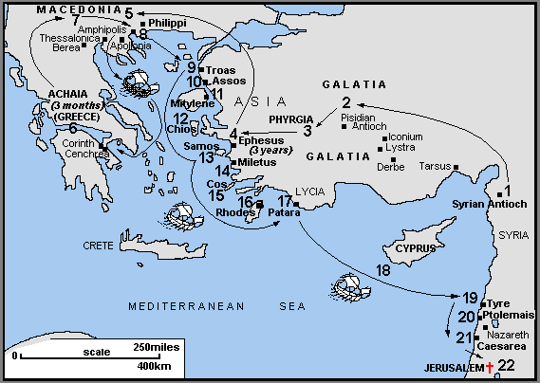

Slide 6
Background and Context
The Galatian churches had fallen into the same error that the Judaizers of Jerusalem had in about 48AD
I am amazed that you are so quickly deserting Him who called you by the grace of Christ, for a different gospel...even though we, or an angel from heaven should preach to you a gospel contrary to that which we have preached to you, let him be accursed...You foolish Galatians, who has bewitched you... (1:6,8; 3:1)
In support of his authority to address the situation, he gives us tremendous biographical data about his early Christian life (chs. 1-2)
He challenges the Galatians to consistency regarding faith, works, the Spirit, and the flesh
Are you so foolish? Having begun by the Spirit, are you now being perfected by the flesh? (3:5)

Slide 7
Structural Keys
Pronouns are important structural keys in Galatians
Most of the interested parties are identified in 1:1-5:
I, Paul
He, God
Us, Paul and the brethren with him
You, the Galatians
Other notable parties mentioned:
He, Peter
They, Judaizers, Peter, Barnabus,etc.

Slide 8
Structural Keys / Outline
From structural keys, the letter can be outlined:
1:1-5 Intro
1:6-2:10 The Sanctification Problem, Paul’s Authority to Address It
2:11-21 Paul’s Track Record in Addressing the Problem
3:1-5 The Error: Salvation Through Works
3:6-4:7 The Correction: Salvation Through Faith
4:8-21 The Error: Walk Through Works
4:22-5:1 The Correction: Walk Apart From Works
5:2-15 The Exhortation: Stand In Liberty
5:16-6:18 The Exhortation: Walk in the Spirit

Slide 9
Grammatical and Syntactical Keys
The word “law (νόμος)” is used 32 times in Galatians
In the NASB, 23 times the word is capitalized (Law), implying reference to the Mosaic Law
In the NASB, 9 times the word is not capitalized (law), implying reference to the general concept of law or ethics.
An Important Syntactical Key: In only 10 references (3:10 [2nd reference], 3:12, 17, 19, 21 [1st reference], 24; 4:21 [2nd reference]; 5:3, 14; 6:2), the definite article is used. In short, there is interpreting by the translators, so we need to pay close attention

Slide 10
Grammatical and Syntactical Keys
3:6 quotes Gen 15:6 from the LXX, and the MT includes the preposition (וְהֶאֱמִ֖ן בַּֽיהוָ֑ה)
The conditional (ἐὰν περιτέμνησθε) in 5:2 helps us understand 5:2-4 as purely hypothetical, and not talking about the Galatians’ losing salvation

Slide 11
Lexical Keys
22 instances of faith (πίστις)
5 instances of love (ἀγάπη)
1 instance of hope (ἐλπίδα, 5:5)
5:22 discusses “fruit” (καρπὸς). Note that the word is in the singular and has the definite article, so all the fruit of the Spirit is to be understood as one unit, not separate units.
6:2 (bear one another’s burdens [βάρη]) and 6:5 (each one bears his own burdens [φορτίον]) in the KJV seem to be contradictory, but note in the Greek, different words.

Slide 12
Biblical and Theological Context
A Few Key Issues/Highlights:
The “sons of Abraham (3:7-9, 28-29)” discussion is explained in Paul’s later letter to the Romans (4). No room for replacement theology here…
3:21-25 identifies the purpose of Mosaic Law, and qualifies all other discussions of the Law
Does 4:24 (“this is allegorically speaking”) introduce a new hermeneutic method?
Who is “the Israel of God” in 6:16

Slide 13
Biblical and Theological Context
Paul explains in ch. 5 the spirit/flesh battle that he later addresses in Romans 7
He explains how we should handle failure (6:1-2) – with gentleness, and bearing the burdens of others.
His closing exhortation is based on a prophecy of God’s expressed righteousness, and presents a comprehensive Christian ethic:
9 Let us not lose heart in doing good, for in due time we will reap if we do not grow weary. 10 So then, while we have opportunity, let us do good to all people, and especially to those who are of the household of the faith.

Slide 14
Prophetic Content in Galatians

Slide 16
Prophetic Content Regarding Position in Christ
1:3-5 – plans for rescue
1:8-9 – false preachers/prophets
1:15, 2:1-2 – prophecy driving Paul’s life and ministry
2:16 – justification not by law
3:2-5 – appeal to fulfilled prophecy in receiving the Spirit
3:6-10 – justification by faith first communicated in prophecy
3:10-14 – Christ fulfills prophecy, the law
3:15-29 (4:1-20)– purpose of prophecy in law, fulfillment in Christ

Slide 17
Prophetic Content Regarding Practice in Christ
5:1-15 – set free for freedom, therefore…
5:5 – position creates anticipation of future (hope of righteousness)
5:16 (17-25)– the command and the conditional outcome
5:25 – means of position provides means of practice
6:7-10 – the future also motivates practice (e.g., as in 6:1-6)

